Slide 1
Ird Data Pipeline Presentation
Castiel Tong

Slide 2
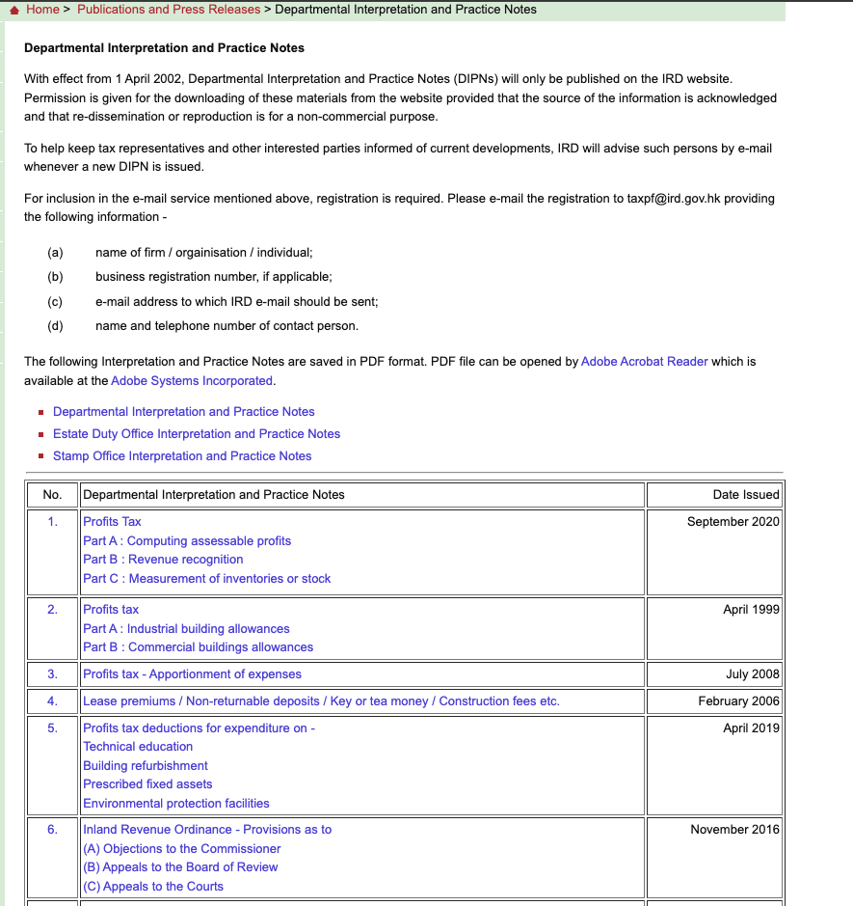
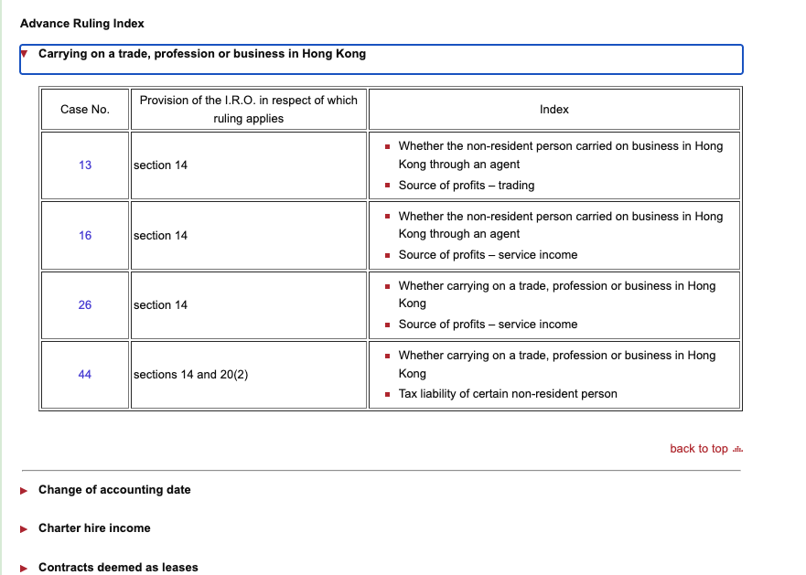
Objective
To Scrape IRD table data from IRD websites(https://www.ird.gov.hk/eng/ppr/arc.htm) and table data from 1-63 (https://www.ird.gov.hk/eng/ppr/dip.htm)
Store those pdf files to a vector search database so that users can search tax related documents with natural language

Slide 3


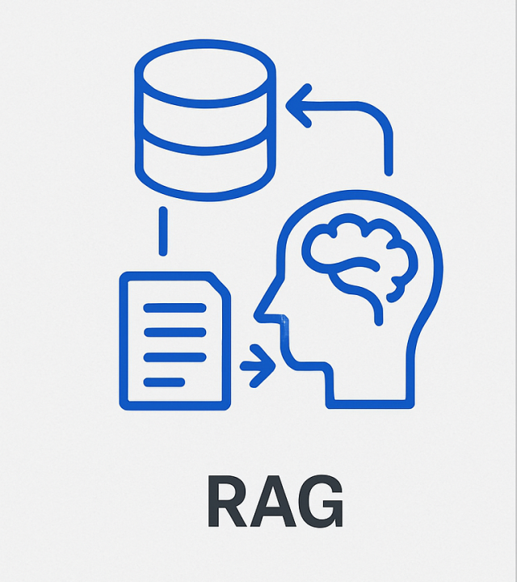
Solution
I built a RAG pipeline with Prefect pipeline orchestration python package to streamline the scraping pdf documents, cleansing the markdown files after pdf conversion and vector search using opensearch
Prefect Cloud provides a convenient UI for controlling and monitoring the pipelines. Opensearch UI could let users to tests the searching performance
Web scraping
Data Cleansing

Slide 4
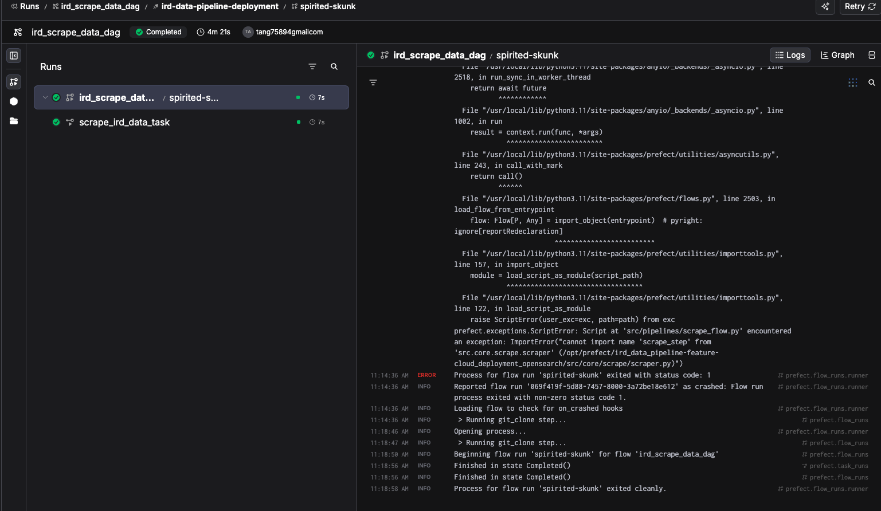
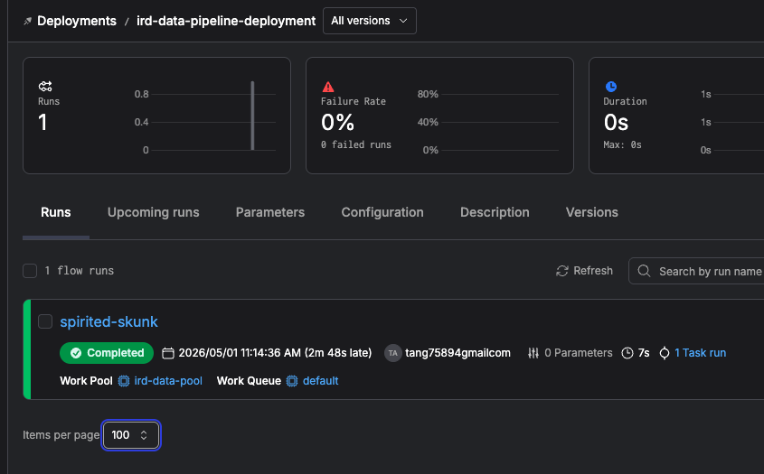
Web Scraping Flow
Scrapy and Beautiful Soup python packages were used to make sure all documents are downloaded
Monitor the scraping process in Prefect Cloud UI with logs

Slide 5
Data Cleansing Flow
It involves file conversion from pdf to markdown where llm models are good to process markdown data
Human-in-the-loop is needed to check the quality of the markdown files(eg. Any missing words, incorrect format, etc)

Slide 6
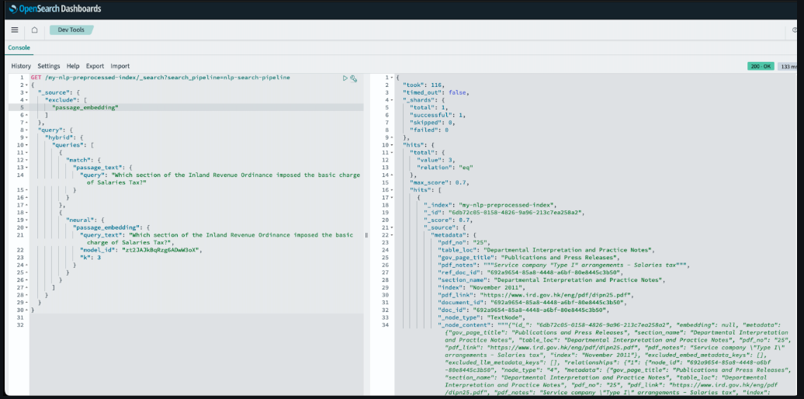
RAG Flow
It uses Opensearch for RAG vector search. It can perform hybrid search with native features to simplify the RAG pipeline, reducing the need for external, custom code
Opensearch has explain API to tune search relevance by showing why a document was ranked highly
There is a UI where developers can test the search result with natural language

Slide 7
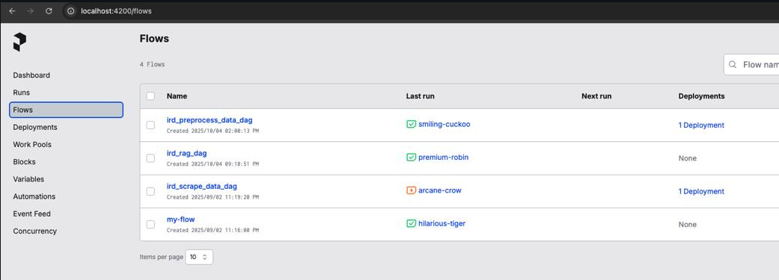
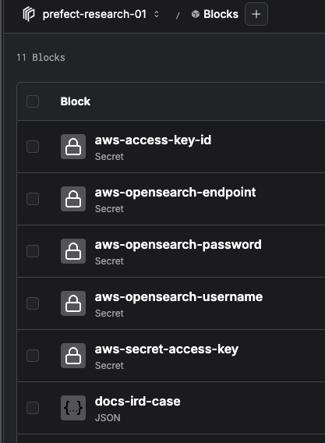
Prefect Cloud
It manages all the flows in a single portal. We can monitoring the deployment process and healthiness of a particular deployment
It also manages secrets so no need to do extra works integrating secret values to Prefect environment which is safer.

Slide 8
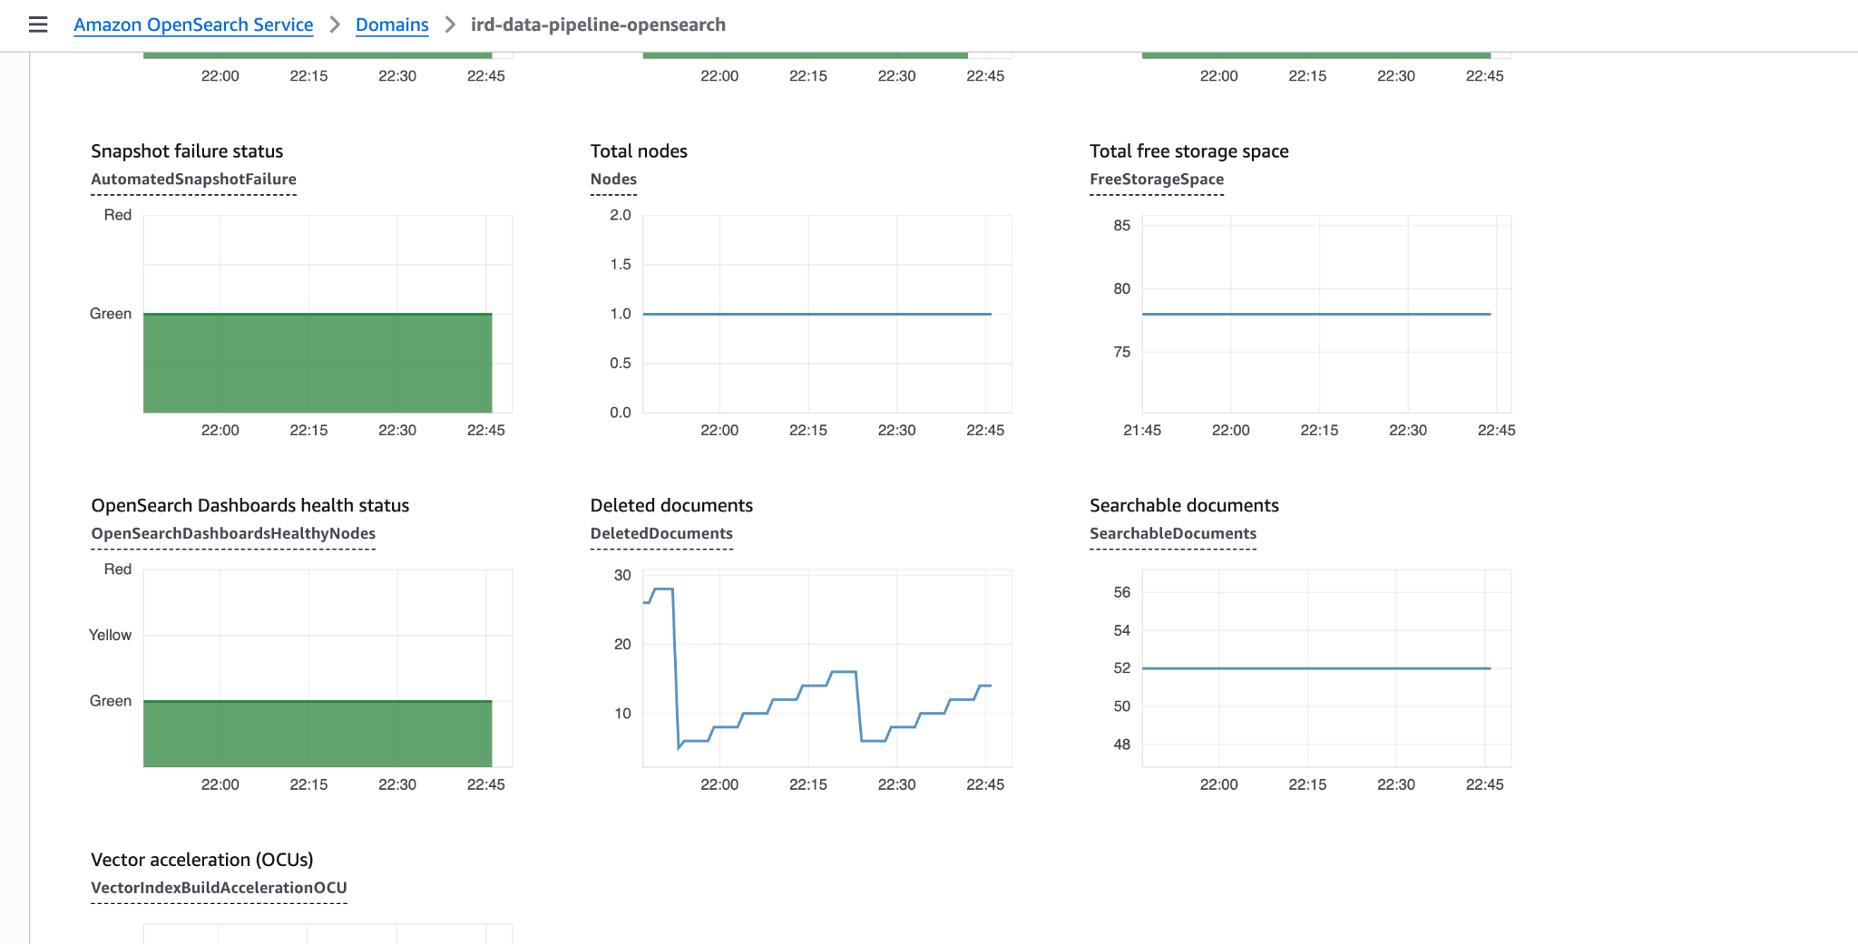
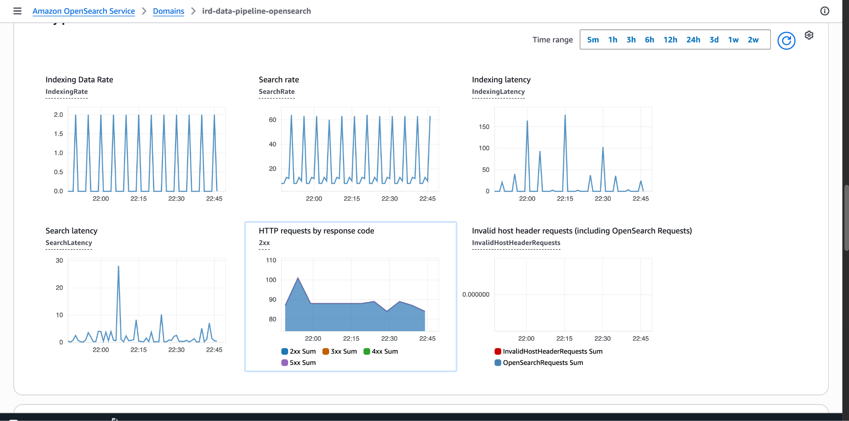
AWS Opensearch Service
The codes support selection on different vector search tools(chromadb, local Opensearch and AWS Opensearch Service)
With AWS Opensearch Service and Prefect Cloud, all the code infrastructure will be setup in cloud

Slide 9
Phase 2 enhancement
Setup a chat model with ollama + interface for user to interact with the RAG conveniently
Setup terraform to deploy hardware
Setup infisical for secrets management since it provides higher security
Setup tailscale for vpn to make sure only my laptop can access the application
Setup time series database such as Prometheus and Grafana dashboard for system health monitoring
Create a opensearch container and deploy to Digital Ocean for long term demonstration purpose

